Slide 1
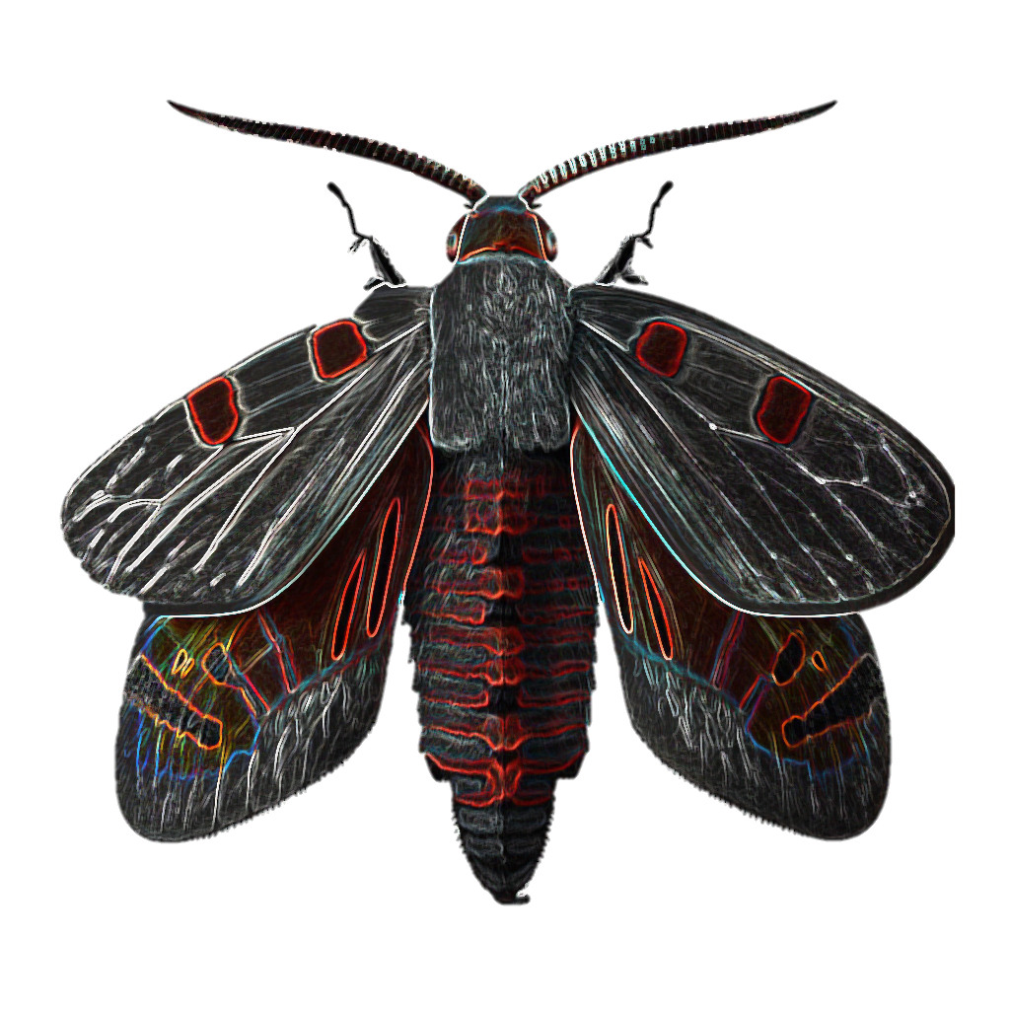
Modelling relative risk of eastern spruce budworm damage across Ontario using an odds-ratio approach
Clara Risk
Stephen Mayor
Patrick M. A. James

Slide 2

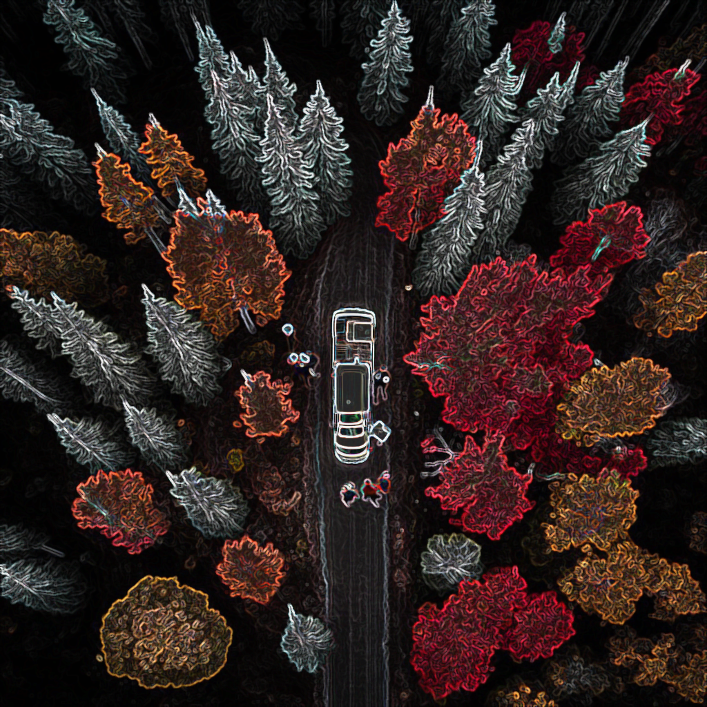
Eastern Spruce Budworm
Eastern spruce budworm is a forest insect pest that attacks spruce and fir trees in Ontario
Its larvae feed on buds, needles, and shoots, causing defoliation, reduced growth, and even tree death
Severe defoliation by the eastern spruce budworm can lead to significant economic losses for the forestry industry
Control measures include insecticides and silvicultural practices

Slide 3

Why Odds Ratios?
An odds ratio is a statistical measure used to compare the likelihood of an event occurring between two groups
Commonly used in medical research to determine the association between a specific risk factor and the occurrence of a disease
It provides valuable information on the strength and direction of an association, and it can help in making informed decisions regarding treatment or prevention strategies

Slide 4
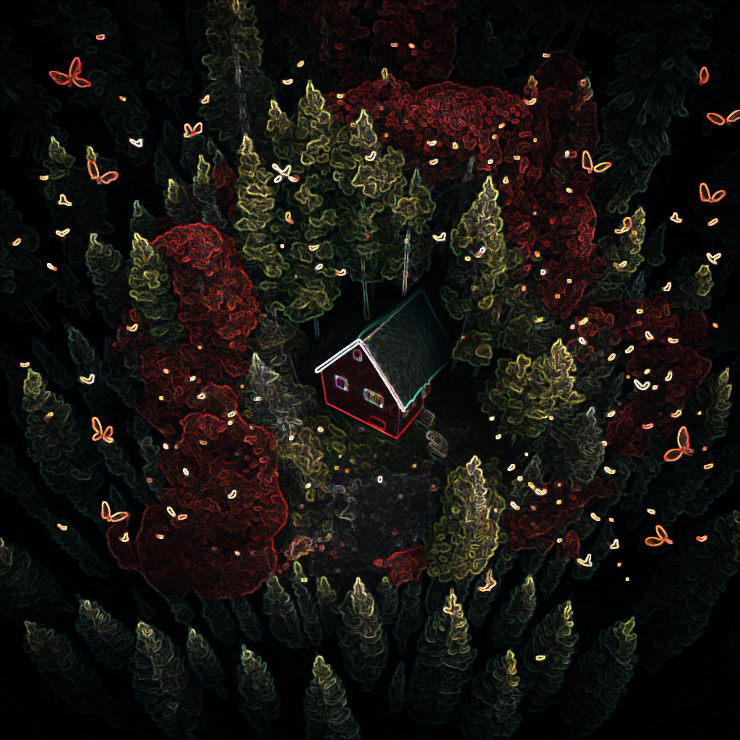
Why this research?
Quantifying and mapping risk of forest stands to spruce budworm helps prioritize management and conservation efforts and identify vulnerable areas for preventive measures
Mapping risk reduces economic losses, protects ecosystem services, and enables effective resource allocation
Odds ratios provide a practical tool to directly quantify forest stand risk

Slide 5
Covariates
Bouchard & Auger (2014):
Higher amounts of balsam fir in a forest stand are an important predictor of higher defoliation during a spruce budworm outbreak
Greater distance from the original defoliation area, greater amount of hardwoods, and greater elevation act as deterrents to the spread of spruce budworm and explain the expansion of the defoliation area
Factors influencing the impact of a spruce budworm outbreak are dependent on the stage of the outbreak
But this study was completed in Québec, which has a very different elevational and climatic profile than Ontario
Our response variable is tree damage
[Insert 3d elevation map of Quebec and Ontario in red and black]

Slide 6
Data Sources

Slide 7
Calculating Odds Ratios
To calculate an odds ratio, you need to compare two groups and see how likely they are to experience a particular outcome
You do this by creating a table, calculating the odds of the outcome for each group, and then dividing the odds of one group by the odds of the other group
It's important to control for any other variables that might influence the outcome – this can be done using linear regression, which allows you to adjust for covariates
An odds ratio greater than 1 means the outcome is more likely in the first group, while an odds ratio less than 1 means the outcome is more likely in the second group
An odds ratio of 1 means there's no difference between the groups

Slide 8
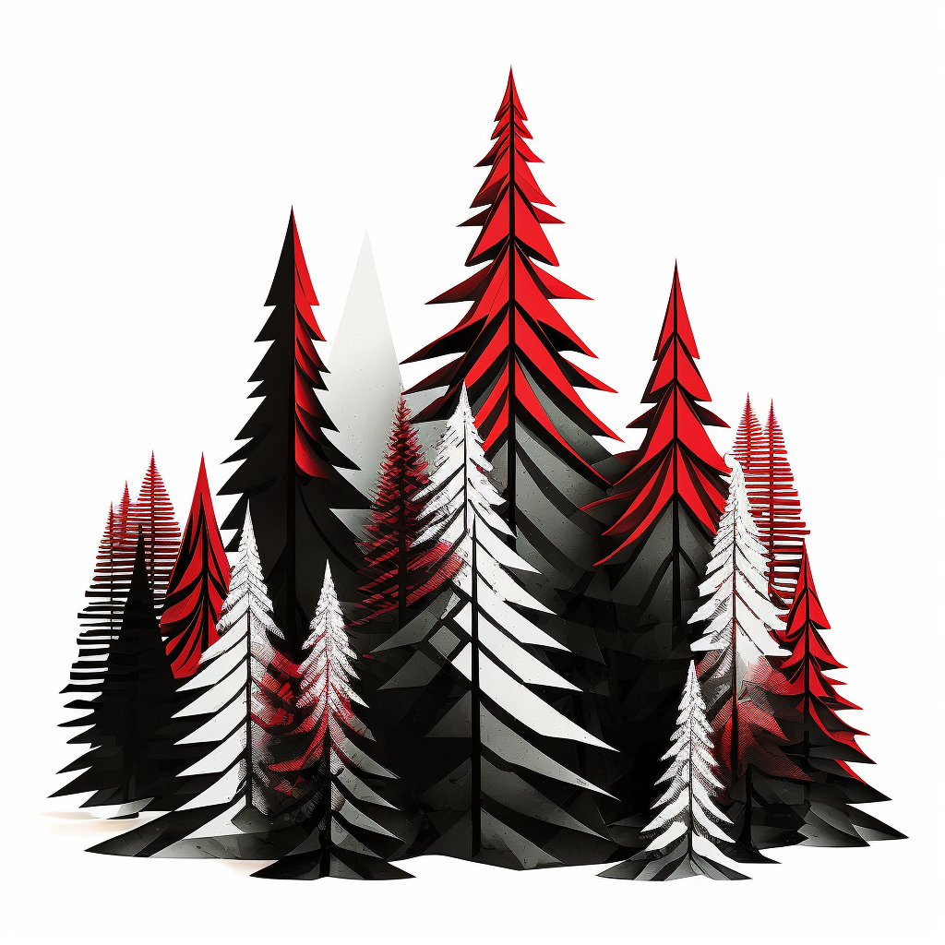
Graphing Odds Ratios
We selected the comparison group by choosing the 45-55th percentile of covariate values to represent an "average" stand in the study area
We iterated through each covariate range at a specific step size and extracted all pixels falling within the buffer size (e.g., 5% for balsam fir)
We calculated the odds ratio for each range of values compared to the "average" stand, and plotted the results on a graph with a 95th confidence interval
The average stand in the study area:
Elevation: 261-299m
Balsam Fir Abundance: 0-2%
Black Spruce Abundance: 34-45%
Stand Age: 70-79 years
Minimum January Temperature: -25 - -26°C
Soil Texture: Loam (Class 7)
Percent of Area Damaged by SBW (2021):

Slide 9
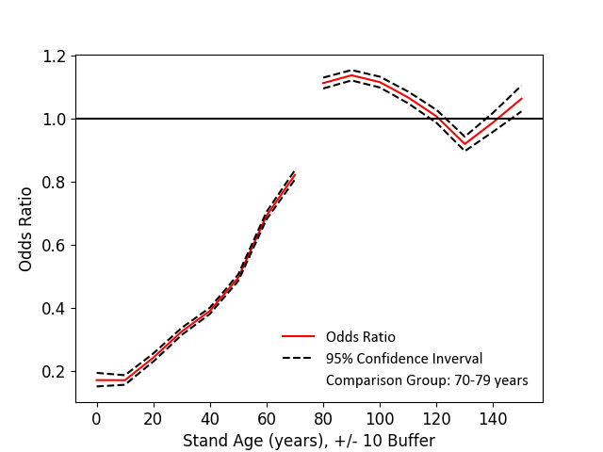
Forest Stand Age
Younger trees are less at risk of SBW damage compared to mature ones

Slide 10
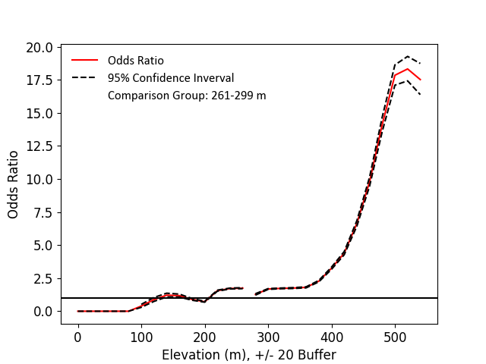
Elevation
Higher elevations in this study area are catastrophically more at risk of damage compared to an “average” stand

Slide 11
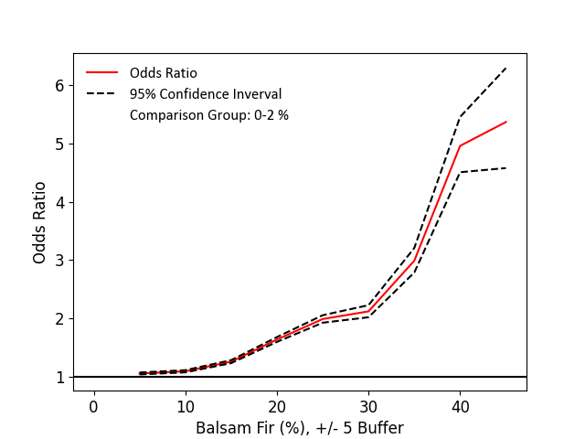
Balsam Fir
Higher abundance of balsam fir in a pixel is associated with a much higher risk of damage compared to an average stand

Slide 12
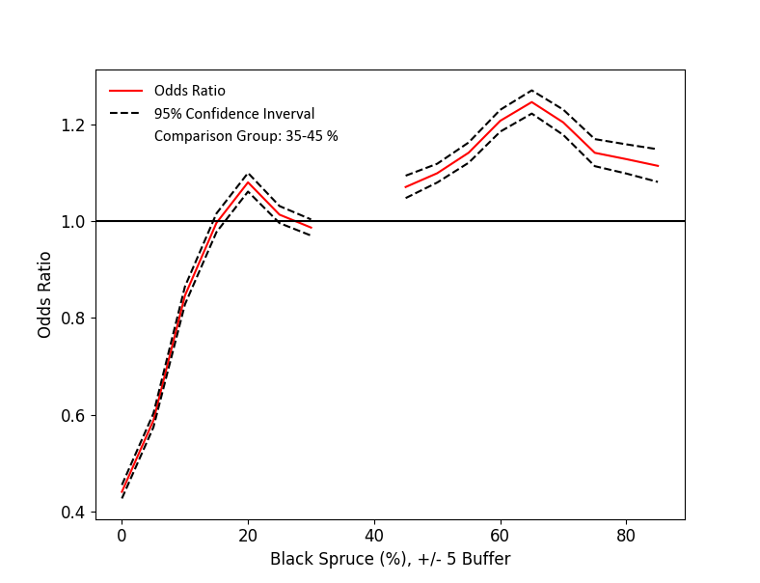
White & Black Spruce
Lower abundance of black spruce in a pixel is associated with a much lower risk of damage compared to an average stand

Slide 13
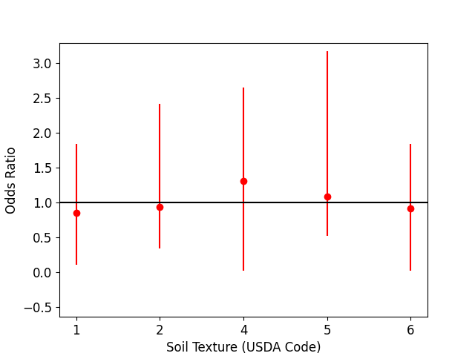
Soil Texture

Slide 14
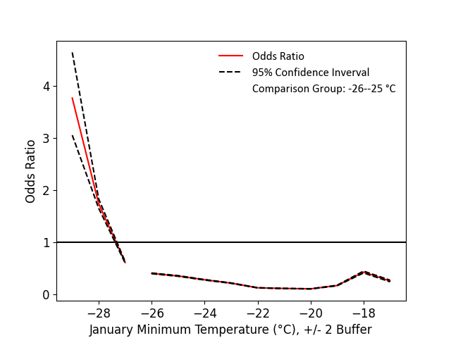
Minimum January Temperature
WARMER = TREES MORE RESISTANT TO DAMAGE?

Slide 15
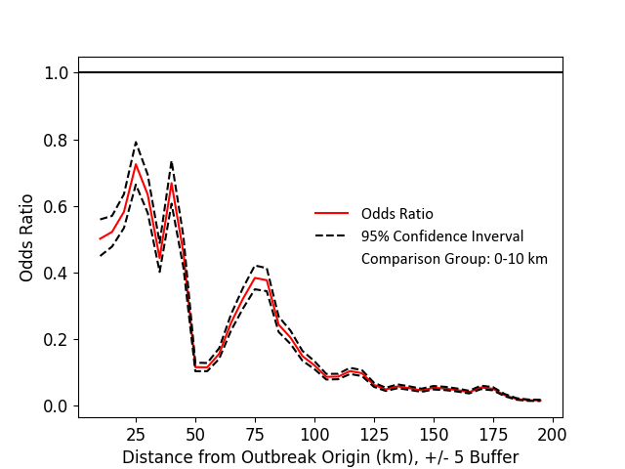
What about spatial autocorrelation?

Slide 16
Summary So Far
Elevation is by far the most important variable – relative risk of damage rises sharply above 400m
Balsam fir follows in importance with relative risk rising sharply past 30% abundance in a pixel
Other covariates less important – generally, more risk is associated with minimum January temperature of 26°C, higher abundances of black spruce, and older stand age

Slide 17
Relative risk of forest stands
Map the odds ratios across Ontario
Multiply the odds ratios together to get a combined risk metric

Slide 18
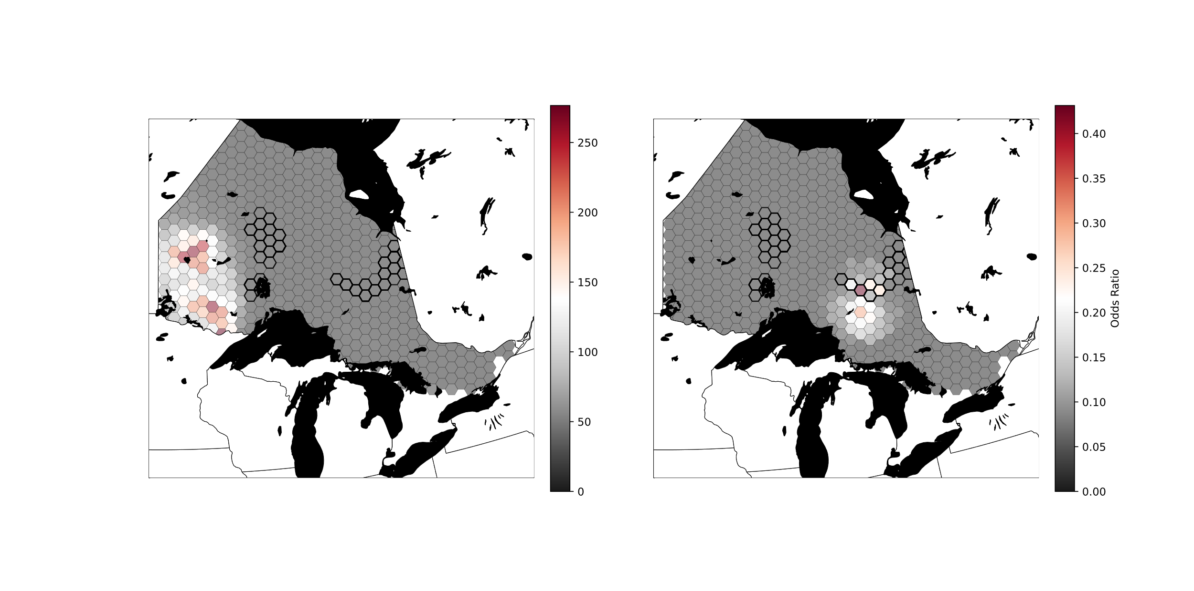
Relative Risk Map

Slide 19
What have we learned?

